Slide 1
Best AP selection using AP Score prediction - NCGO6BMS
Internal Mentor : Dr. Kayarvizhy N External Mentor : Saranappa Raj Kumar
Kavin Kumar Thangadorai
Student members: Ajit J Gupta
Akash V
Manoj Howale S

Slide 2
EXPECTATIONS/KPI
iMPLEMENT ANDROID APP TO COLLECT WIFI DETAILS
dEFINE SCORING METHOD FOR EACH AP BASED ON ITS USAGE AND PERFORMANCE
CHECK GOOGLE AP SCORING ALGORITHM FROM ANDROID OPEN SOURCE
Select best AP based on scoring, come up with ML based technique to solve the same problem
comparE RESULTS, apply the solution to sticky banD or sticky clIENT problem in Wifi

Slide 3
Last month progress
Analysis on
Research papers
related to Access points
Google scoring algorithm
Implementation of android app
to collect wifi details
ML model
Basic
Research
Analysed the parameters present in a access point.
Analysed how android app can be used to collect wifi details.
Analysed the Google scoring algorithm to try and collect the same parameters from app interface that was used in the algorithm.
Implemented multiple ML model for predictive analysis and modeling.
Analysed various research papers to understand how various algorithms are used to calculate total score.
Created an android app in java that can collect details from wifi in real time and write to a CSV file

Slide 4
KPIs achieved
iMPLEMENT ANDROID APP TO COLLECT WIFI DETAILS
dEFINE SCORING METHOD FOR EACH AP BASED ON ITS USAGE AND PERFORMANCE
CHECKED GOOGLE AP SCORING ALGORITHM FROM ANDROID OPEN SOURCE
Select best AP based on scoring and come up with ML based technique to solve the same problem

Slide 5
Android app
The app is designed using java language.
The android app collects wifi parameters such as: Ssid, rssi, base score, frequency, link speed, channel bandwidth.
The data collected from the app is written to a csv file which is used to train the ML model.
The data is collected every 10 seconds and added to the csv file.

Slide 6
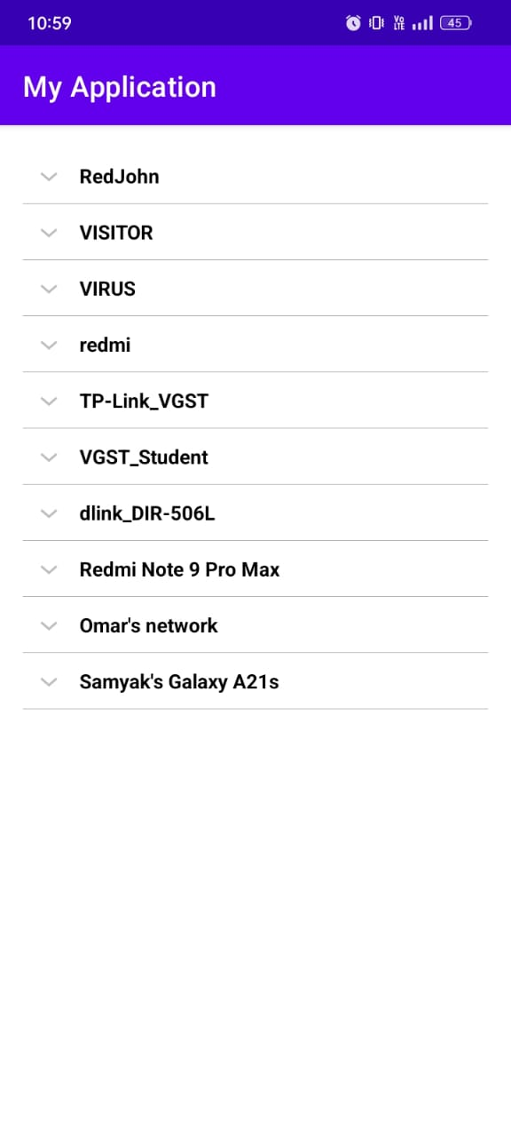
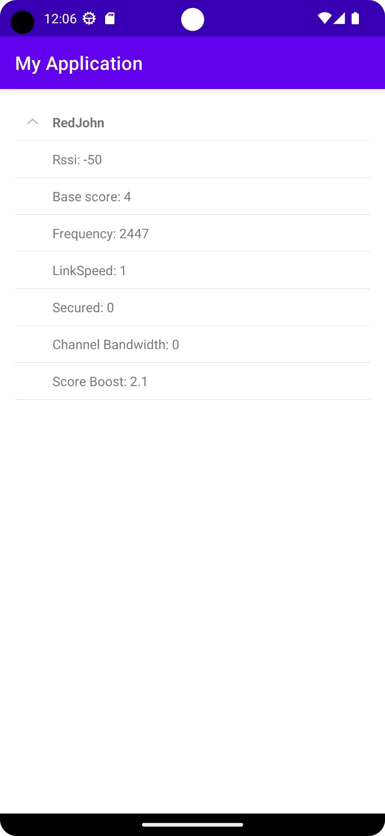

Slide 7
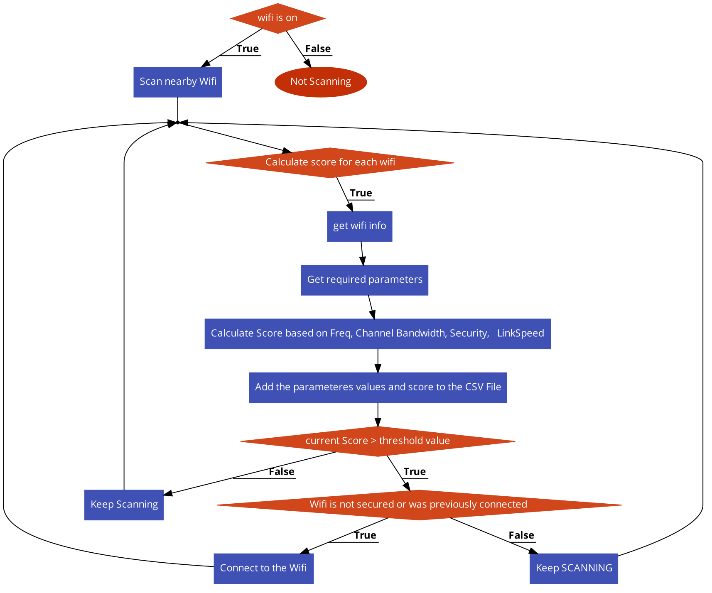
Flow chart depicting the sequence of operations in the app.

Slide 8
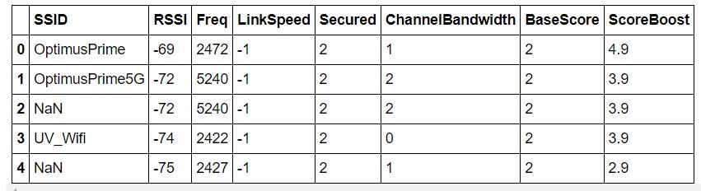
Data collected from app

Slide 9
Google scoring algorithm
Parameters used in Google scoring algorithm
BSSID
RSSI
Channel frequency
Bandwidth
Channel conditions
Maximum number of spatial streams
Signal strength
Number of connected users
Network latency
Number of hops

Slide 10
Google scoring algorithm
If the device is connected to a Wi-Fi network, the framework evaluates whether the current network is good enough to skip network selection.
A network is defined as good enough to skip network selection if any of the following requirements are met:
Less than 10 seconds have elapsed since the last network selection.
The user recently manually connected to the network.
The device is connected to an online sign up (OSU) connection.
The RSSI is above the required RSSI threshold or sufficient traffic is flowing over the connection.
The network is validated (connected to the internet) or is user-approved for use without internet access.
The network is unmetered.

Slide 11
Google scoring algorithm
If the connected Wi-Fi network isn't good enough or if the device isn't connected to a network, then a list of Wi-Fi networks is filtered based on scan results.
The scan results are filtered to remove BSSIDs that have an RSSI below the entry RSSI. BSSIDs can be blocked based on repeated connection failures, frequent disconnects, and explicit requests from the AP to not attempt association for a certain period of time (MBO-OCE).
When the device is rapidly moving, the scan results are optionally further filtered to remove BSSIDs whose RSSI varies rapidly (indication that they aren't moving along with the device).
The framework runs the candidate scorer to generate a score for each service set identifier (SSID) candidate. The candidate with the highest score is the winning candidate.

Slide 12
Google scoring algorithm
Candidate scorers evaluate and provide a score for each candidates based on the following conditions:
A base score is computed based on RSSI where RSSI is capped at -73 dBm for the 2.4 GHz band or -70 dBm for the 5 GHz and 6 GHz bands.
A score boost is computed based on a throughput estimate derived from the technology, channel frequency, bandwidth, RSSI, channel conditions, the maximum number of spatial streams, and other parameters.
A candidate network that was recently selected by the user or by an app gets a large score boost for a duration.
A secure network is scored higher than an open network.
An unmetered (free) network is scored higher than a metered (paid) network.
Untrusted networks are scored lower than any other network.
A network that was previously detected to have no internet gets a score of 0 if the device is currently connected to another network that has internet access.

Slide 13
Ml model results
Linear regression Model
The data is fitted using the linear regression model.
While fitting the data points it is observed that the data is overfitted and hence lasso is used to avoid overfitting.
By applying lasso it deviates to a more natural fitting and realistic prediction.
Since there is more deviation from the original curve this causes the accuracy to go to 63%

Slide 14
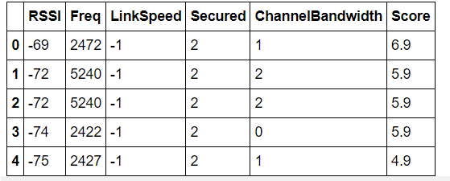
Y = a*x1 + b*x2 + c*x3 + d*x4 + e*x5 + k
Where, x1, x2,x3,x4,x5 are the coefficients of parameters as shown in table.
Values which we got after training out data :
X1 = 7.66102376e-01
X2 = -4.26259429e-01
X3 = 1.11022302e-16
X4 =3.85382400e-01
X5 = 5.54095303e-01
K = 5.182799807709071

Slide 15
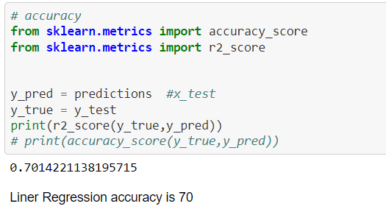

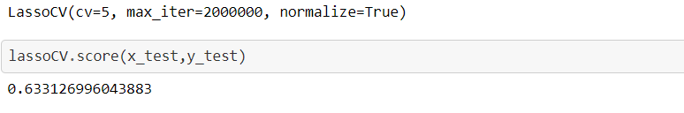

Slide 16
Ml model results
Artificial neural network Model
We use an artificial neural network to both classify and predict the new value.
The neural network consists of four layers(2 hidden) with multiple nodes connected to each other. Hence forming the ANN.
It consists of 6 units in each hidden layer.
Tensorflow and keras libraries are used to implement the model.

Slide 17
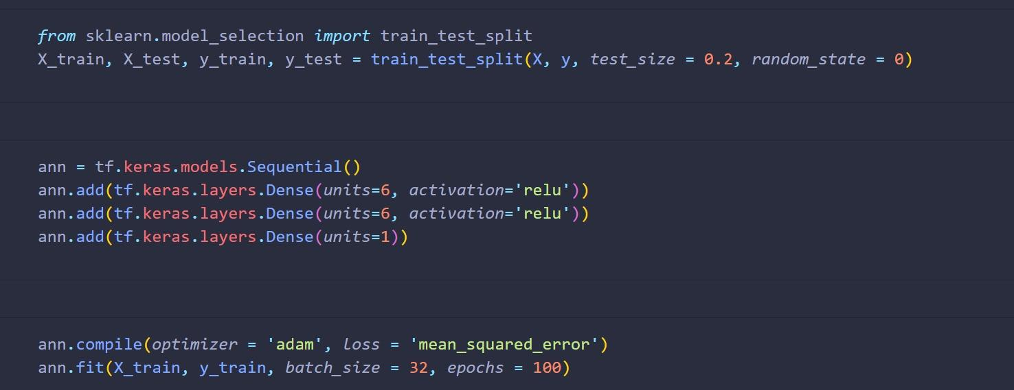
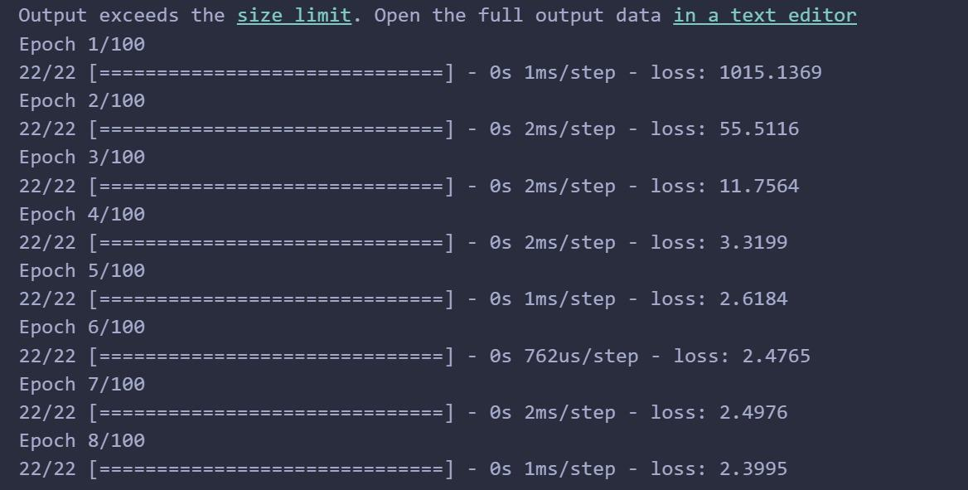

Slide 18
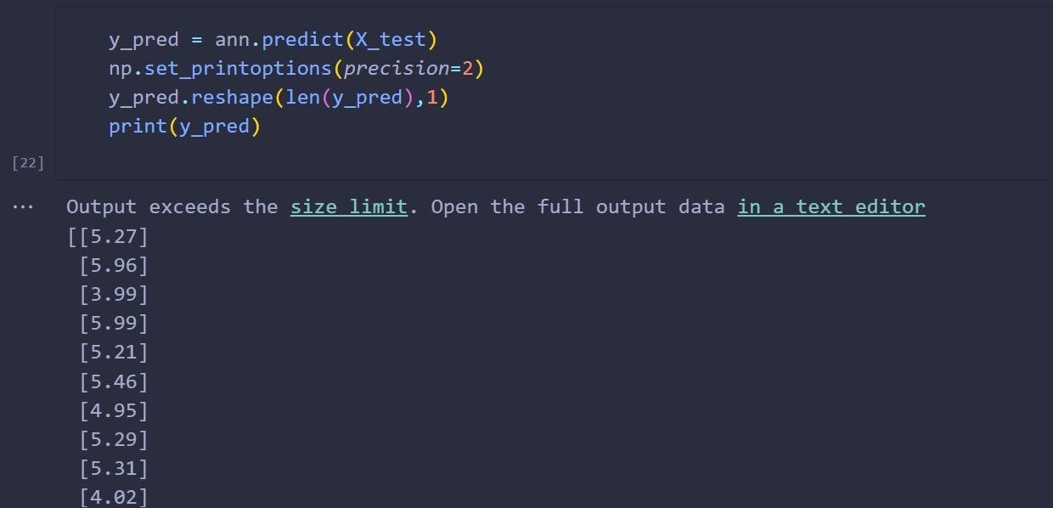
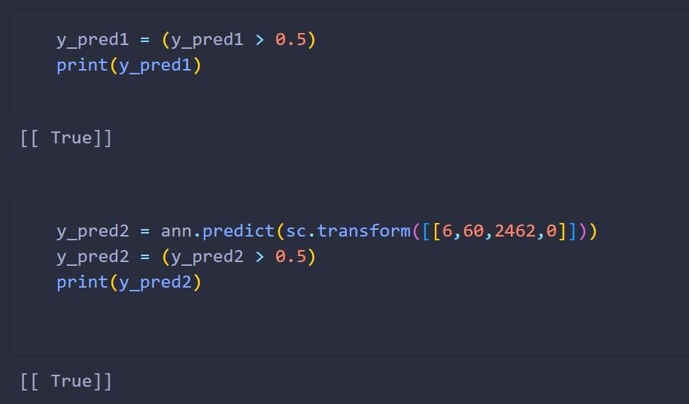

Slide 19
Ml model results
Support Vector Machine Model
Support vector regression uses the same principle as SVM but for regression problems.
The main objective is to find the best fit line which is the hyperplane that has the most number of training points in it.
Standard scaler is used to normalize the data (frequency in our case)
Kernel used is RBF kernel. (Radial basis function)

Slide 20
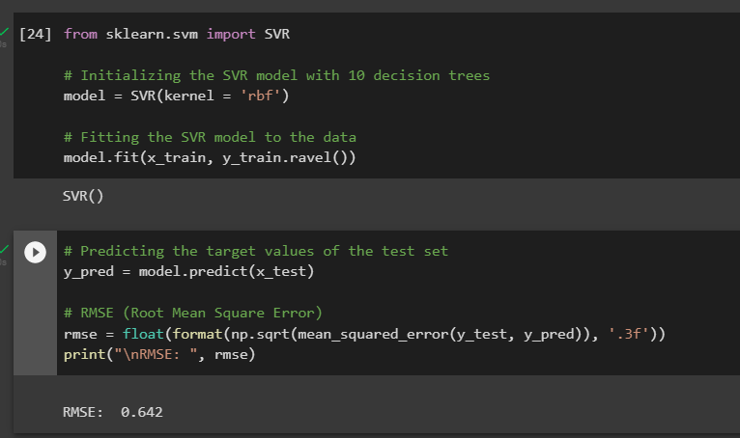

Slide 21
Problems faced by team
Google scoring
algorithm
Data set generation
Major parts of the code is depreciated.
Requires a lot of interdependent functions defined in other classes of the algorithm.
Data-set that is generated every 10 seconds is similar to the previous data which causes the data to be overfitted.
Bulk of the dataset falls in the middle region, extreme values are sparse.

Slide 22
Observations
1
2
Data set
Ml model
The data set that is generated is similar to the previous reading and this adds duplicate data to the data set.
The model is too closely fit to the training data, resulting in poor performance on new data.
3
App interface
4
Sticky band
The current design is minimalist to its purpose as currently we are storing all the data in CSV.
When we will be able to switch to the best performing AP nearby then this can be solved

Slide 23
Upcoming Month’s plan
Data set
ML model
A wide variety of data set will be collected.
An optimum model will be chosen based on accuracy
App interface
Threshold based algorithm
The threshold based algorithm will consider more parameters and conditions as described in google scoring algorithm
App interface improvement

Slide 24
Thank you

